Slide 1

0
Lecture 8
Translation
1

Slide 2
Lecturer details
What is translation
Translation process
Translation types
Translation strategies
2

Slide 3




What is translation
Target Language
Source Language
Translator
3

Slide 4
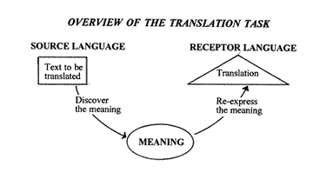
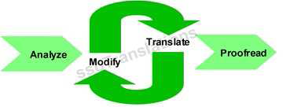
Translation process
1.
2.
4

Slide 5
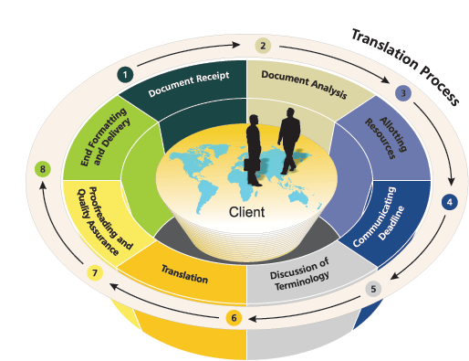
Professional translation stages
5

Slide 6
Translation terminology
Source language The language of the original message.
Target language The language of the resulting translation or interpretation.
A language - Native language B language - Fluent language C language - Working language
6

Slide 7
Translation vs. Interpretation
Translation is written - it involves taking a written text (such as a book or an article) and translating it in writing into the target language.
Interpretation is oral - it refers to listening to something spoken (a speech or phone conversation) and interpreting it, orally, into the target language.
7

Slide 8
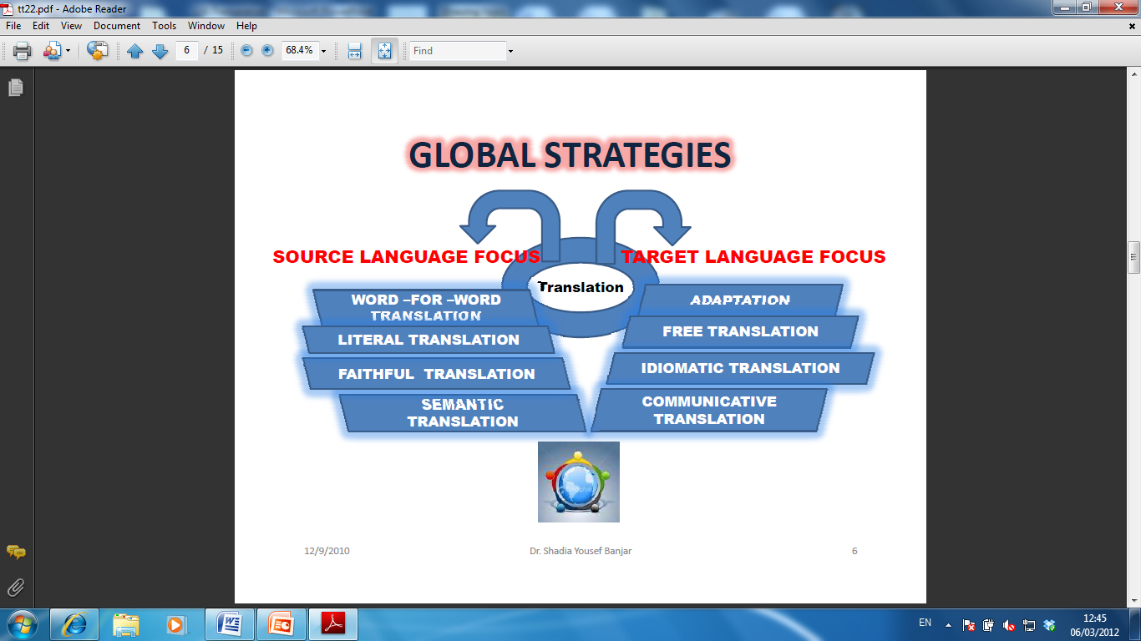
Translation strategies
8

Slide 9
Source language translation
1) word-for-word translation:
A word-for-word translation does not alter the grammar at all; you keep everything in the same order: I go to school.→
The boy is eating the lunch.→
Your English is a little rusty.→
2) literal translation:
A literal translation preserves the meaning of the words, but rearranges them so that they fit the syntax of their new language: Give me a hand →
Sleep on it →
Like the back of my hand →
Advertise Your Business Here
9

Slide 10
Source language translation
3) faithful translation:
stays, if possible, within the constraints of the grammatical structures of the target text.
I played football
I have played football
4) semantic translation: more emphasis on naturalness than in faithful translation;
“we will not tire, we will not falter, and we will not fail.” president Bush says.
07/05/2014
Human Development University Computer Science Department
9

Slide 11
Target language focus
adaptation: the freest form of translation and
more of a target language/culture based interpretation of the source text
2) free translation: focuses on the content of the target text rather than the form.
Meaning is important…..
3) idiomatic translation: makes use of idioms and phrases that are not present in the source text.
4) communicative translation: aims at reproducing the exact message of the source text content-wise and context-wise
10

Slide 12

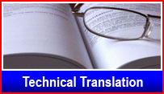

Types of translation
Financial translation and interpretation
Legal translation and interpretation
Literary translation
Medical translation and interpretation
Scientific translation and interpretation
Technical translation and interpretation
11

Slide 13
End
Thank you
??????
12

